Slide 1
Final Presentation
3D Applications Network
Brandon Cernohous July 28th, 2023

Slide 2
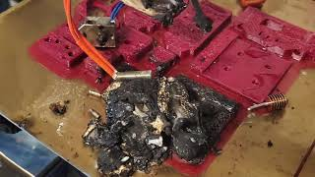

Slide 3
Analysis of the local-global topic
3D printing of advanced materials hard, and basic materials like PLA have functional limits. This leads to underutilization of technology and capabilities. At worst the challenges lead users to abandon the technology completely. Individual users may struggle to use 3D printing in their own projects. Materials enable the application!
Challenges
Lack of material science knowledge - lots of poor quality information online
Hundreds of parameters
Optimization is time consuming - 4-8 weeks to create a robust profile per resolution
Difficult for companies adopting 3D printing to dedicate time
Difficult/expensive for hobbyists
No repository. Learnings are lost or duplicated
OEMs want to sell their own materials - minimal 3rd party support
Diversity of hardware, software, slicer, materials, modifications leads to huge complexity
Experts difficult to find

Slide 4
Formulation and explanation of the project
My goal was to build a community space where users of different, materials, systems, etc could come together with industry experts to solve problems. And collect knowledge to prevent the loss of learning. This was a multifront effort.
Short Term Goals (Implementation in progress)
Educational guide meant to teach good optimization strategies for new materials
https://3d-applications-network.gitbook.io/tuning-guide/
Discord channel as a space for users to connect in real time
https://discord.gg/sAGAUmfG
Long Term Goals (Future State)
Create an agnostic repository that can intake data from multiple softwares. Searchable my material and system. Contain important context not included in config files. Represent multiple technologies
Create content on which Material to select
Content on which Technology to use. UV, FFF, SLS, etc
Create a rating system to validate which profiles are most functional
Implement AI to predict parameters for new combinations
Create a forum focused on materials optimization on a wide range of platforms

Slide 5
Interventions + Experiments
Local use cases - Bee hotel
Assisted in selecting and tuning a material for a “bee hotel”
Material tuning took 2-3 weeks to complete for an “ok” profile
Used the process to create a guide for finding material parameters
Existing communities - Facebook user groups
Shared guide in existing communities - facebook users groups
Wide variety of feedback
Mostly negative comments regarding the quality and accuracy of my content
Large amounts of unreliable information
Local Makerspace
Only allows 1 material in print lab
90% of these users have never tried a different material
50% have only used one brand
Most wouldn’t know where to start
Industry Experts
Reached out to 10 industry connections for engagement in the project
All agreed that expert level materials help is necessary
All 10 have reservations about participating due to non competes, employee agreements

Slide 6
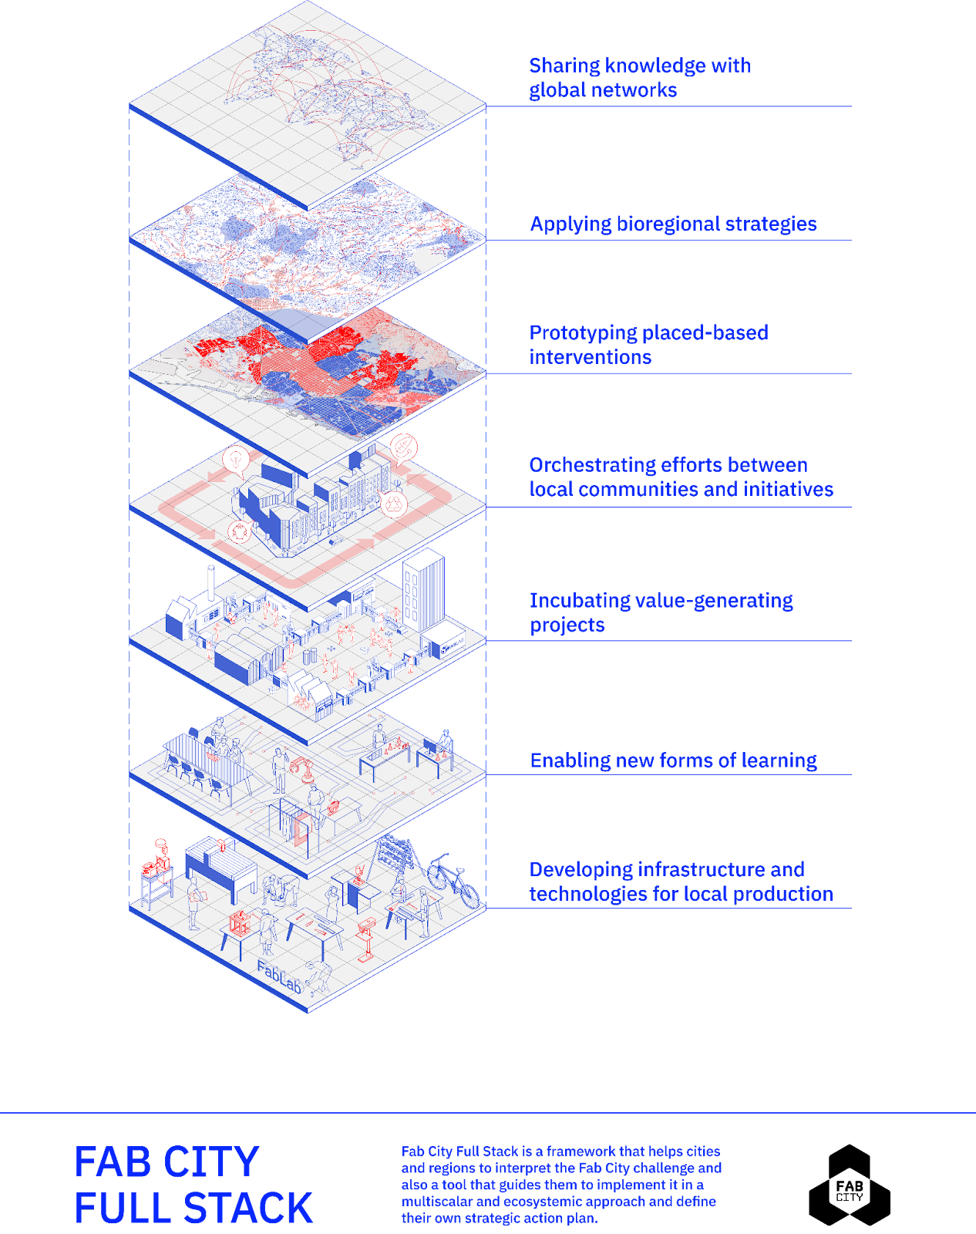
Full stack implementation strategic plan
Global network
Discord
Tuning Guide - Materials education
Planetary
Encourage/enable regionally made materials
Connect users to similar projects
Business using 3d printing in new ways
Territorial
Makerspaces
Workshops
Individual projects (Bee Hotel)
Communities

Slide 7
Co-creative /design activities
Feedback
Create the guide and educational content first. Follow up with the database later.
Target guides to users who may have never changed settings on their printer or used a material other than PLA. - Maker Space
80% never change from PLA or material that comes with machine
50% never change brands
Educate on why the material matters. People don’t understand the differences between polymers. - Bee hotel
No repositories exist today. Effort is lost or duplicated.
Need tool to archive, compare, access for different configurations
Forums can make for good archives to
Need experts to lead
Active 3D industry workers have NDA challenges
Search for high level users outside of 3d industry - Fablab, makerspaces, other communties

Slide 8
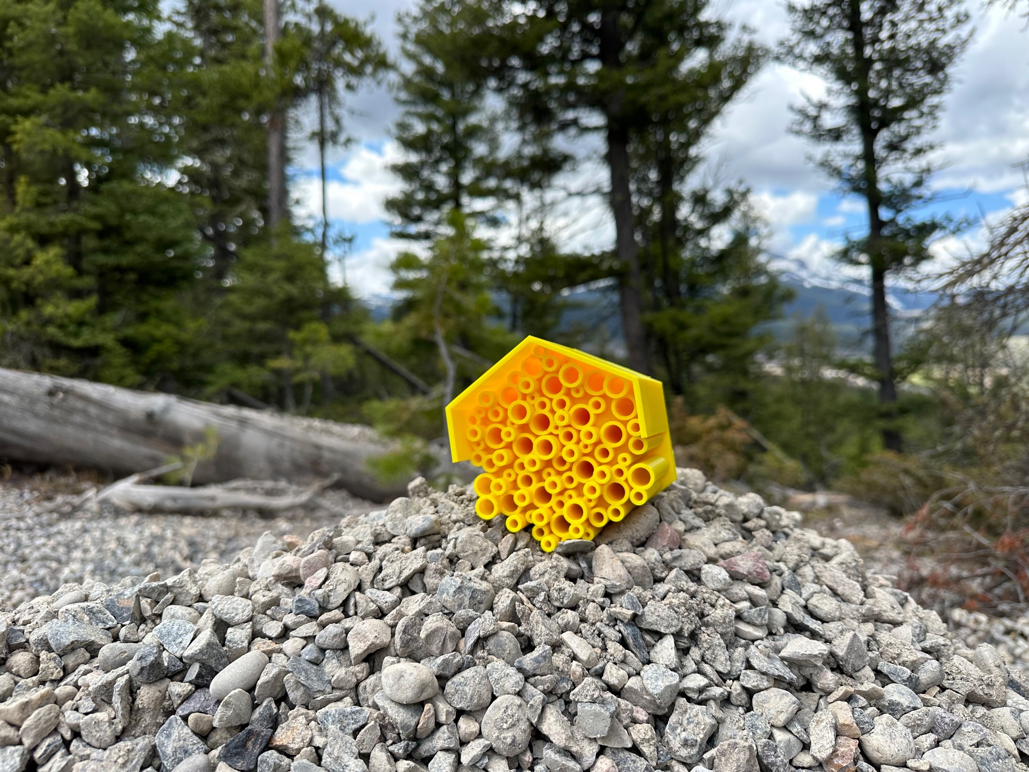
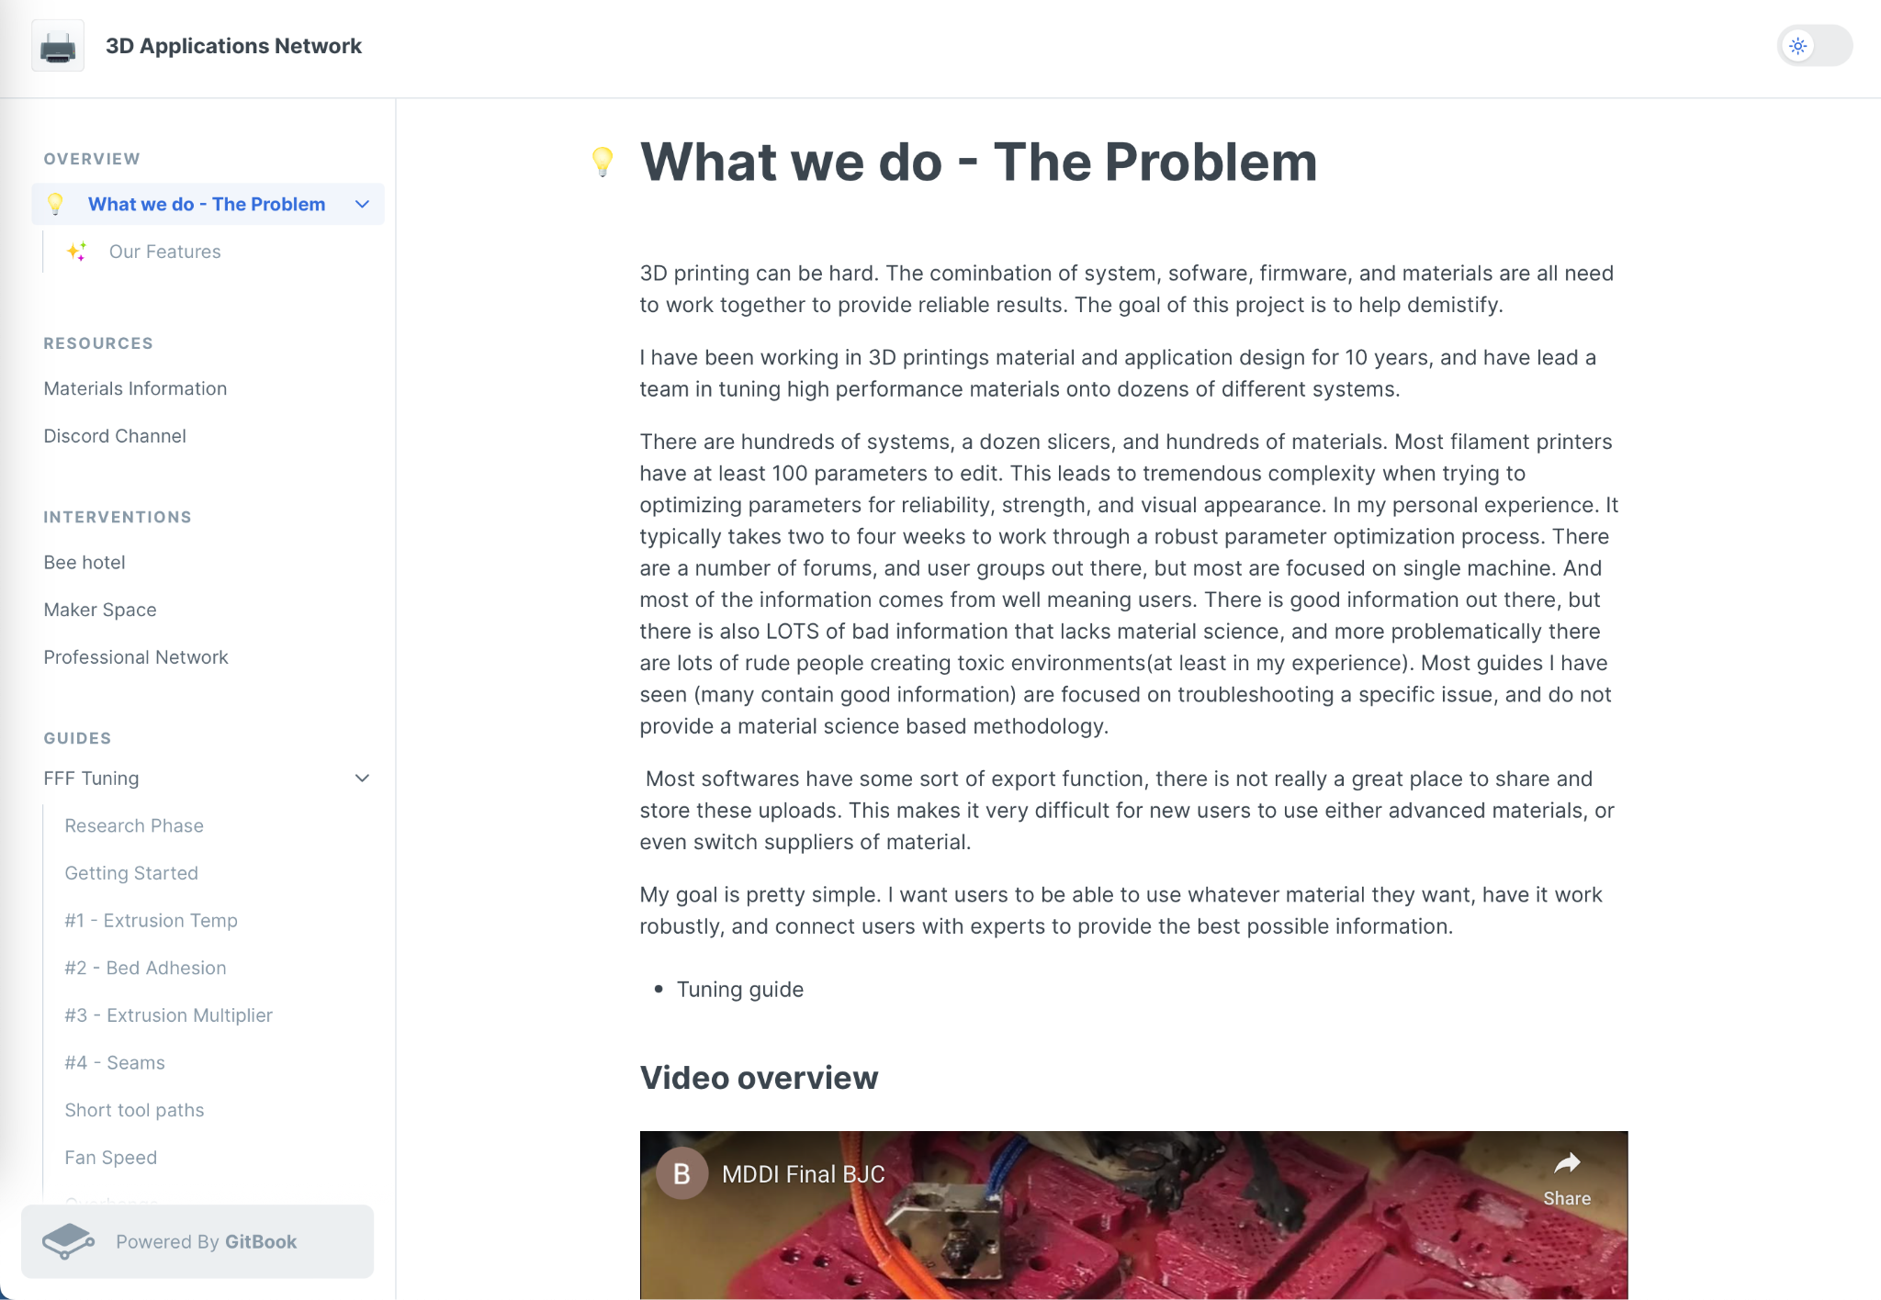
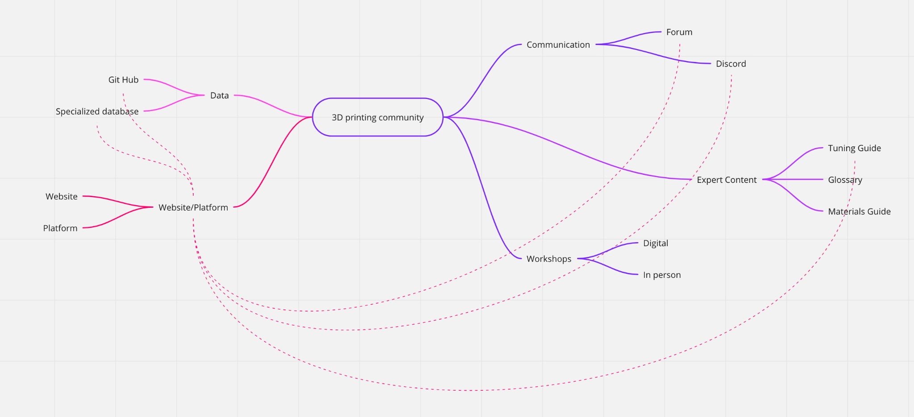
Map
Bee House
Gitbook
Project map

Slide 9
Social, economical, and environmental impact
Impact 1 - The goal is for users to to take on more serious, technically demanding, or challenging projects. Being able to more easily use high performance materials will enable new application spaces, or make longer term manufacturing of parts possible rather than just prototypes.
Impact 2 - By giving users the freedom to choose the manufacturer of their material, more people we will be able to choose more locally manufactured materials and reduce the transportation cost/burden.
Impact 3 - By shifting to functional parts rather than prototypes. It is more likely that these parts will be in service for longer periods of time and reduce the need for replacements as frequently.
Impact 4 - Time - It can takes weeks to develop robust material profiles. These efforts are frequently repeated over and over due to the lack of system to share the information.

Slide 10
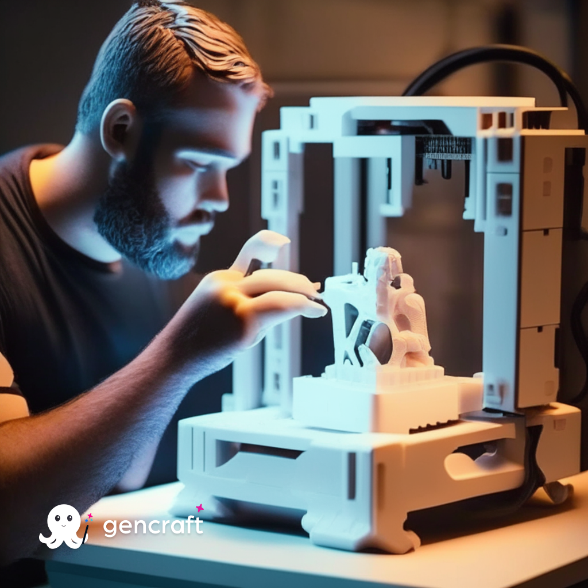
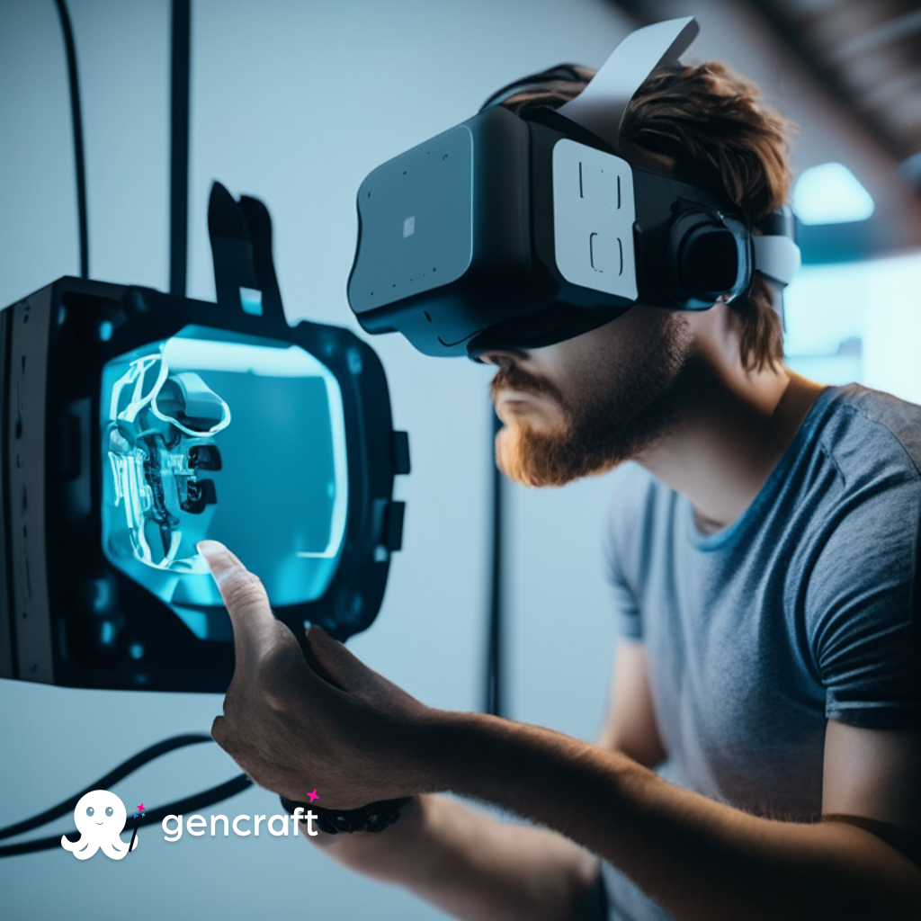
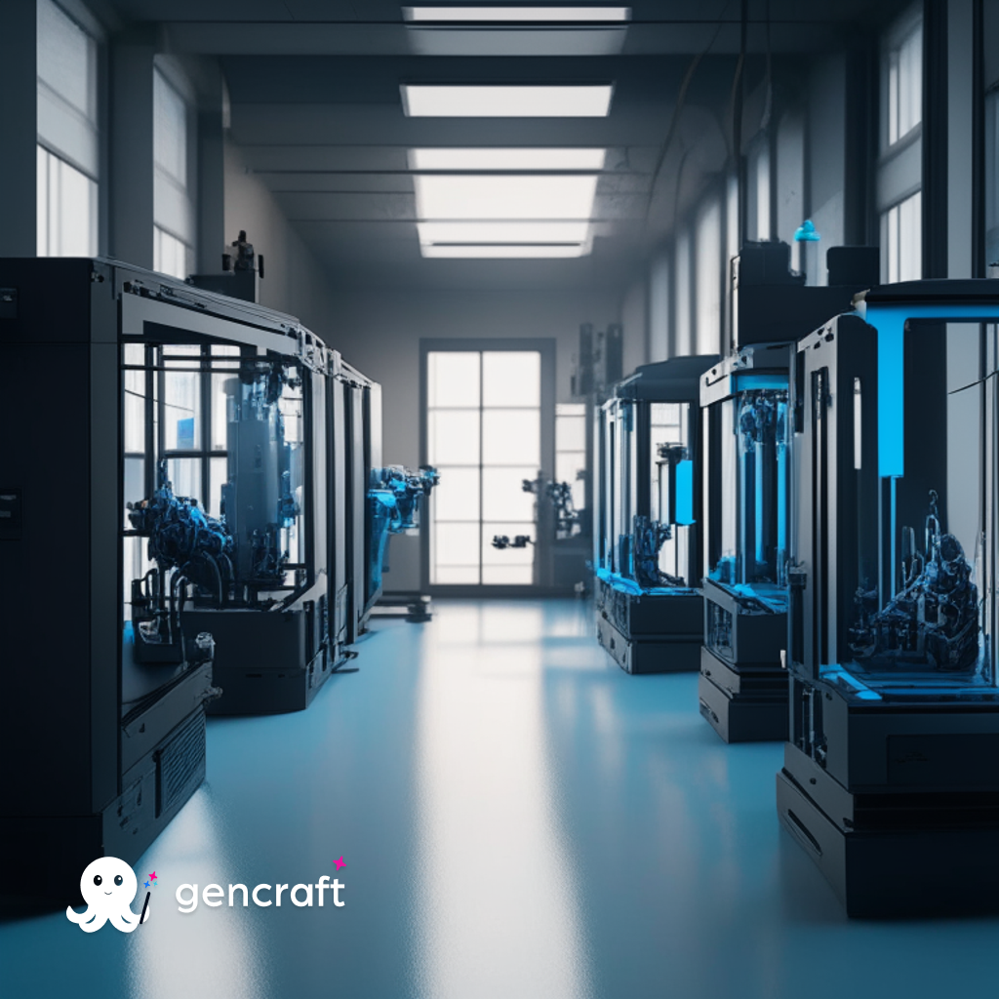
1, 5, 10 year vision
User creating new things, interacting virtually with next generation digital tools, and printers approaching the ease of Star Trek replicators.

Slide 11
Thank you

